Slide 1

Heart Disease Analysis
Kanithra S 23BDS021

Slide 2

Transform

Slide 3
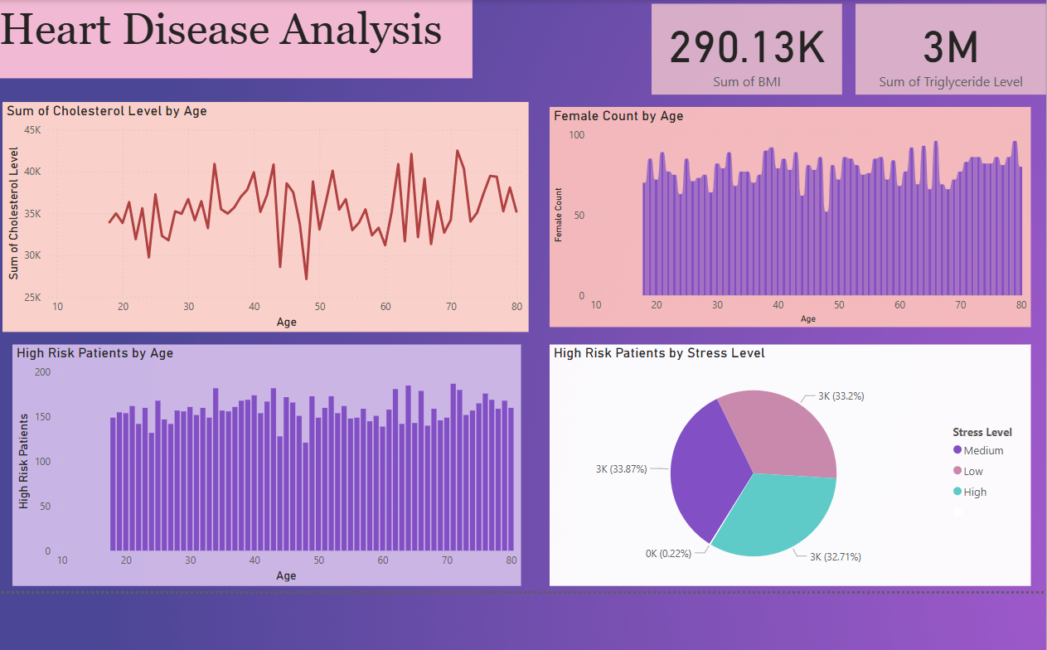
Dashboard

Slide 4
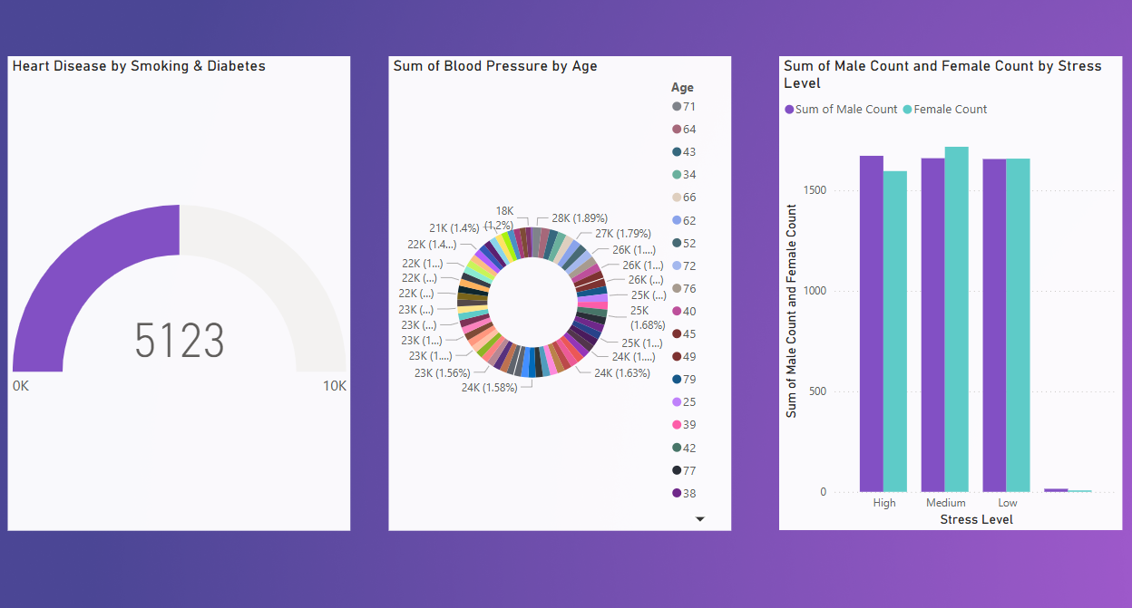
Dashboard

Slide 5

Insights
Smoking & Diabetes contribute to 5,123 heart disease cases, indicating a strong link between these factors and cardiovascular issues.
High-risk patients are mostly aged 30-70, showing that middle-aged and older individuals are at greater risk.
Cholesterol levels fluctuate, with peaks around 40-50 and 60-70 years, suggesting these age groups need closer monitoring.
Blood pressure is distributed across all age groups, but certain ages (e.g., 28K cases at 71 years) show higher prevalence, reinforcing that hypertension is a critical concern.
The total BMI sum is 290.13K, which suggests obesity might be a key factor in heart disease risk.
Triglyceride levels total 3M, reinforcing the need for diet and lifestyle changes to prevent lipid-related heart disease.
Female count remains consistent across age groups, meaning heart disease affects both genders relatively equally.
The Male and Female stress-level distributions are similar, but medium and high-stress levels have the highest patient counts, indicating stress management is crucial.
Medium stress level accounts for the highest percentage of high-risk patients (~33%), while low-stress individuals still face significant risk.
Patients with zero stress have a negligible high-risk count (0.22%), reinforcing stress as a contributing factor to heart disease.

Slide 6
Summary
Routine screenings for individuals over 40 years to monitor cholesterol and blood pressure levels.
Implement dietary interventions (low-fat, low-sodium diets) and medication adherence programs for high-risk groups.
Weight management programs through nutrition counseling and fitness initiatives to reduce BMI.
metabolic and cardiovascular differences in men and women for personalized treatment plans.

